Slide 1
NETWORK FLOW

Slide 2
Flow Network is a directed graph that is used for modeling material Flow.
It involves a source(S)and a sink(T)and several other nodes connected with each other.
Network Flow is a subsection of graph theory related specifically to situations where something moves from one location to another.
An easily visualized example of network flow is piping system through which a quantity of water must pass.

Slide 3
Definition:
A Flow Network is a directed graph G = (V, E) such that
For each edge (u, v) ∈ E, we associate a nonnegative weight capacity c (u, v) ≥ 0.
If (u, v) ∉ E, we assume that c (u, v) = 0.
There are two distinguishing points, the source s, and the sink t;
For every vertex v ∈ V, there is a path from s to t containing v.

Slide 4

Let G = (V, E) be a flow network.
Let s be the source of the network, and let t be the sink.
A flow in G is a real-valued function f: V x V→R such that the following properties hold:
Capacity Constraint: For all u, v ∈ V, we need f (u, v) ≤ c (u, v).
Skew Symmetry: For all u, v ∈ V, we need f (u, v) = - f (v, u).
Flow Conservation: For all u ∈ V-{s, t}, we need

Slide 5
The three properties can be described as follows:
Capacity Constraint makes sure that the flow through each edge is not greater than the capacity.
Skew Symmetry means that the flow from u to v is the negative of the flow from v to u.
The flow-conservation property says that the total net flow out of a vertex other than the source or sink is 0. In other words, the amount of flow into a v is the same as the amount of flow out of v for every vertex v ∈ V - {s, t}

Slide 6
The quantity f (u, v), which can be positive or negative, is known as the net flow from vertex u to vertex v.
In the maximum-flow problem, we are given a flow network G with source s and sink t, and we wish to find a flow of maximum value from s to t.

Slide 7
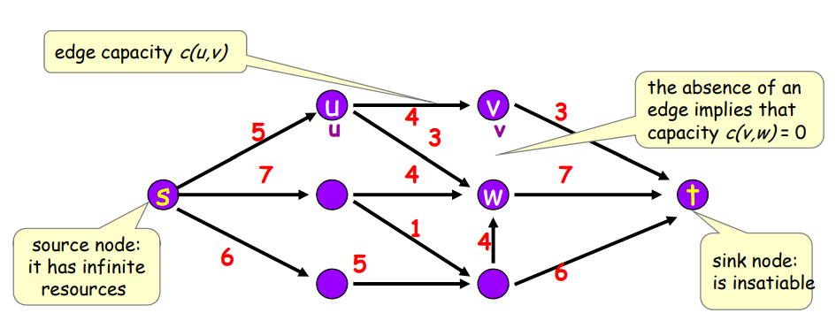
insatiable: always wanting more and never feeling satisfied

Slide 8


